Slide 1
CONNECTS
“Human connection is the key to personal and
career success.”
~Paul J. Mayer

Slide 2

VIDEO CONFERENCING WEB APPLICATION
Group Members:
Ishita Gupta
Piyush Singh
Anushree Singh
Harshit Singh Chandel
Project Guide:
Dr. Satyasundara Mahapatra

Slide 3
OVERVIEW
PROJECT OBJECTIVE
INTRODUCTION
METHODOLOGY
ABSTRACT
TECHNOLOGY USED
SYSTEM REQUIREMENT
FUTURE SCOPE
REFERENCES

Slide 4
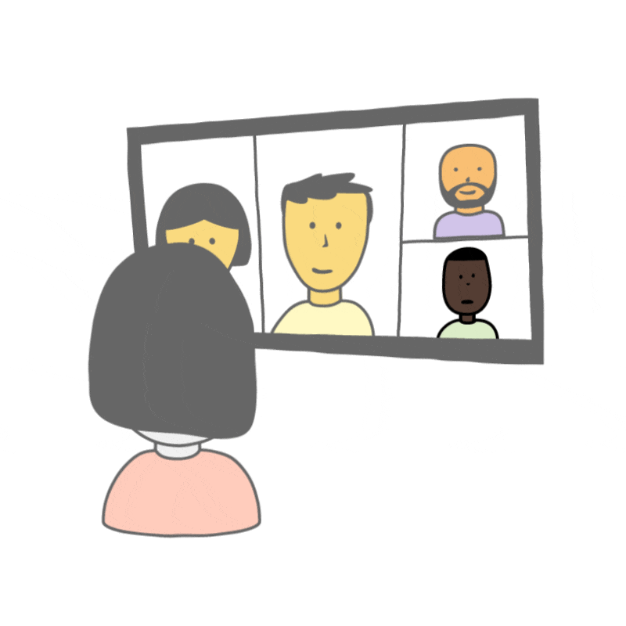
Project Objective
Video conferencing is to enable face-to-face communication between two or more people in different locations.
A high-quality online video meeting provides an environment that will feel like you are sitting down across from other participants in the same room and gives you that face-to-face contact needed to build trust and relationships.
It gives a simple way to meet face-to-face, video conferencing delivers a collaborative, “in-person” experience without the expense of travel.
It can be used for team meetings, webinars, product demos, job interviews, and more.
It provides Distance Learning which is a relatively new educational field that focuses on delivering classroom content/instruction to students who are not physically on site. Instead, teachers and students communicate either asynchronously or using technology that allows them to communicate in real-time.

Slide 5
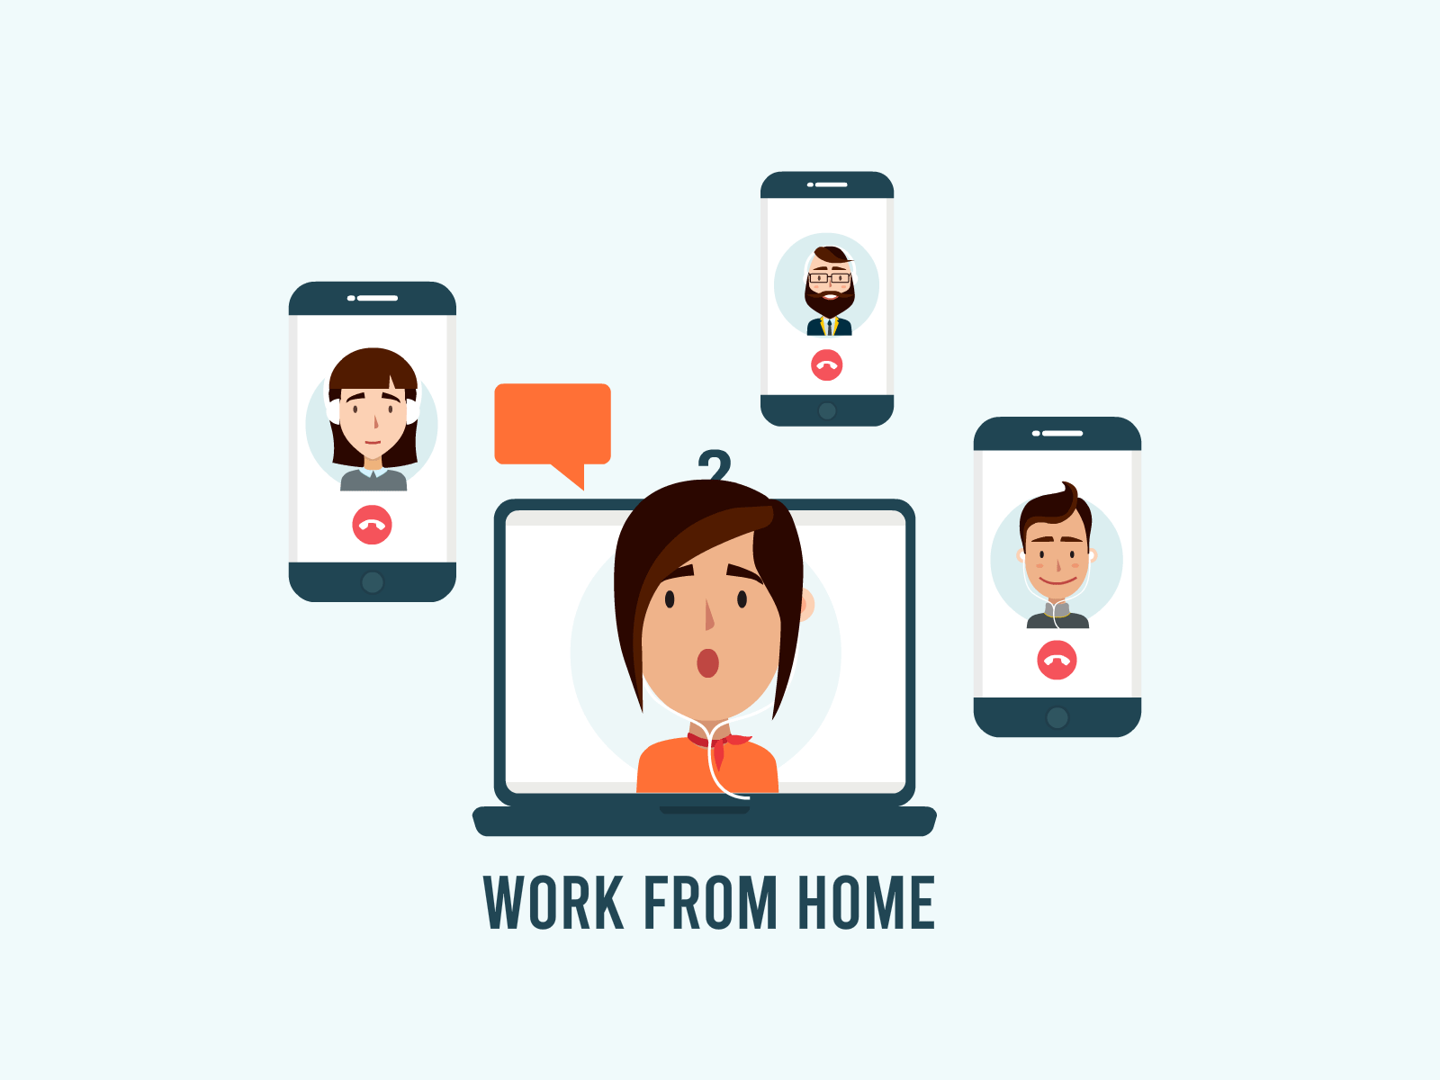
Introduction
Video conferencing is a type of virtual, online meeting where two or more people talk through a video and audio call in real-time. Video conferencing has been around for years, but it skyrocketed in popularity as school and work shifted into the home during the 2020 pandemic.
This application provides advanced video and audio quality due to more efficient compression and can function over normal broadband internet connections.
Video conferencing application can be used to share documents and display information on whiteboards.
This application provides educators a more interactive distance learning experience by delivering real-time, bidirectional video, voice, and data communications to their distance students.
This project provides the video conferencing platform in which users can communicate with each other in their own private room, companies can use it for project discussion , interviews and presentation.

Slide 6
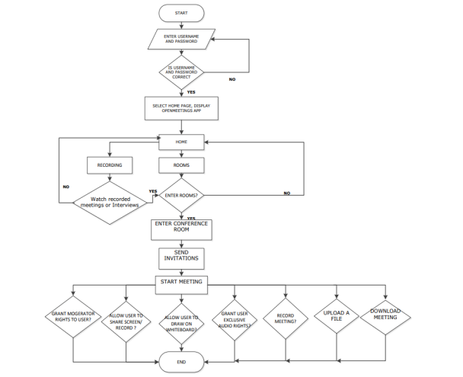
METHODOLOGY

Slide 7

Abstract
The purpose of making this video conferencing application is to provide better understanding of the views and ideas between two and more people.
This application will provide all the necessary features which are required to have better communication and exchange of ideas like screen recording, sharing a YouTube video, unlimited private room, inviting some third person, live chat room, mute audio and disable video.
The aim for this video conferencing application is to provide a user friendly platform where users can communicate with each other and have better communication and also schools and colleges can guide their students from a distance.
Users can simply log in or Users can create an account on this application and get started with video calling and conferencing.

Slide 8










Technology Used
Frontend:
HTML 5
CSS 3
JavaScript 6
ReactJS
Backend:
Node.jS
Express.js
Socket.io
Firebase
Database:
MongoDB
MERN Stack

Slide 9
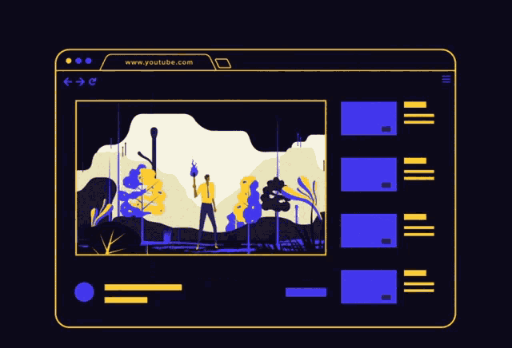
FRONTEND:
HTML 5: HTML stands for Hyper Text Markup Language. It is used to design web pages using a markup language .Hypertext defines the link between the web pages. The markup language is used to define the text document within the tag which defines the structure of web pages.With this new version of HTML, you can create web applications that work offline, support high-definition video and animations.
CSS 3:Cascading Style Sheets Level 3 (CSS3) is the iteration of the CSS standard used in the styling and formatting of Web pages. CSS3 incorporates the CSS2 standard with some changes and improvements.
Javascript 6: JavaScript 6 is used to make web pages dynamic and interactive. It means using JavaScript, we can change the web page content and styles dynamically.JavaScript also known as a scripting language for web pages.
ReactJS: ReactJS is a declarative, efficient, and flexible JavaScript library for building user interfaces. It is an open-source, component-based front-end library that is responsible only for the view layer of the application.

Slide 10
BACKEND:
NodeJS : It is an open-source and cross-platform runtime environment built on Chrome’s V8 JavaScript engine for executing JavaScript code outside of a browser. You need to recollect that NodeJS isn’t a framework, and it’s not a programing language. It provides an event-driven, non-blocking (asynchronous) I/O and cross-platform runtime environment for building highly scalable server-side applications using JavaScript.
ExpressJS: Itis a small framework that works on top of Node.js web server functionality to simplify its APIs and add helpful new features. It makes it easier to organize your application’s functionality with middleware and routing. It adds helpful utilities to Node.js HTTP objects and facilitates the rendering of dynamic HTTP objects.
Socket.io: Earlier, websites used to reload every-time a resource was requested. This introduced unnecessary delays which increased average wait time. Often users had to wait for minutes to fetch a particular page or file. Socket.IO is a library that enables real-time, bidirectional and event-based communication between the browser and the server ehich decreases the wait time.
Firebase: is a mobile application development platform from Google with powerful features for developing, handling, and enhancing applications. Firebase is a backend platform for building web and mobile applications.

Slide 11

DATABASE
MongoDB:It is the most popular NoSQL database, is an open-source document-oriented database. The term ‘NoSQL’ means ‘non-relational’. It means that MongoDB isn’t based on the table-like relational database structure but provides an altogether different mechanism for storage and retrieval of data.
Relational Database Management System(RDBMS) is not the correct choice when it comes to handling big data by the virtue of their design since they are not horizontally scalable. If the database runs on a single server, then it will reach a scaling limit. NoSQL databases are more scalable and provide superior performance. MongoDB is such a NoSQL database that scales by adding more and more servers and increases productivity with its flexible document model.

Slide 12
System Requirement
Hardware Requirement:
Windows 8 or above / Linux Operating System
Minimum 4 GB RAM
Minimum quad Core Processor
Microphone
Camera
Software Requirement:
Any web browser (for eg. Chrome, firefox , edge etc.)

Slide 13
Future Scope
User Registry – Maintains a list of registered users in our database and allows only those users to use our application.
Dynamic Rooms – The rooms are created dynamically giving users the freedom to name the rooms according to their choice.
Video conferencing - Supports live video conferencing for multiple rooms at the same time Canvas sharing - Real-time whiteboard sharing with one controller (who can be changed).

Slide 14
References
[1] ARPN Journal of engineering and applied science ARPN (Asian Research Publishing Network) Topic: P2P Audio and video calling system
[2] International journal of engineering and computer science ISSN;2319-7242. Topic: Design and implementation of a virtual machine video conferencing application By; Adeyinka A.Adewala, Samuel N.john, Dike U.like.
[3] International conference on computational and information Science (ICCIS) Topic: Audio video conference system research based on P2P and Multicast.
[4]https://www.lifesize.com/en/company/news/press-releases/2019/impact-video-conferencing-report
[5] https://en.m.wikipedia.org/wiki/Jitsi
[6] https://firebase.google.com/docs/firestore/quickstart#java
[7] https://iconscout.com/free-icons

Slide 15
The most important thing in life are connection you make with others”.

Slide 16
Group Members
Name | Roll No. | Branch & Section
Anushree Singh | 1901640100070 | CS-4 C
Harshit Singh Chandel | 1901640100134 | CS-4 E
Ishita Gupta | 1901640100139 | CS-4 B
Piyush Singh | 1901640100192 | CS-4 C

Slide 17
Thank You

